Slide 1


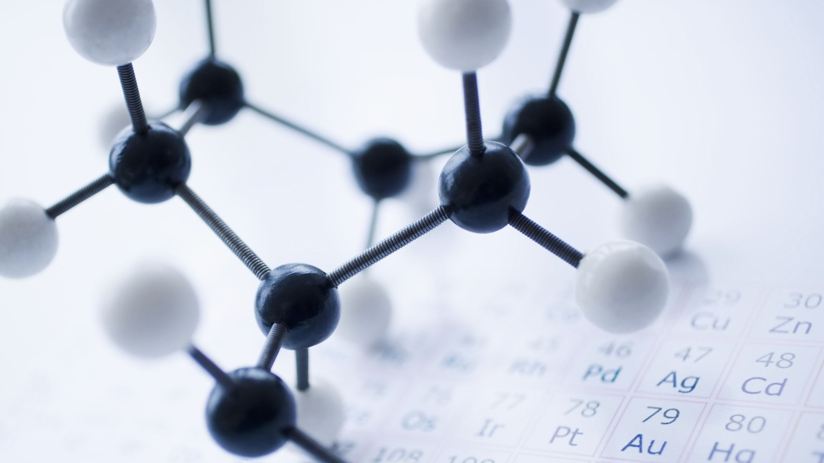
basics of Atomic Theories
M.Nabeel
25F-CY-065
Notes:
Are your classroom colors different than what you see in this template? That’s OK! Click on Design -> Variants (the down arrow) -> Pick the color scheme that works for you!
Feel free to change any “You will…” and “I will…” statements to ensure they align with your classroom procedures and rules!

Slide 2

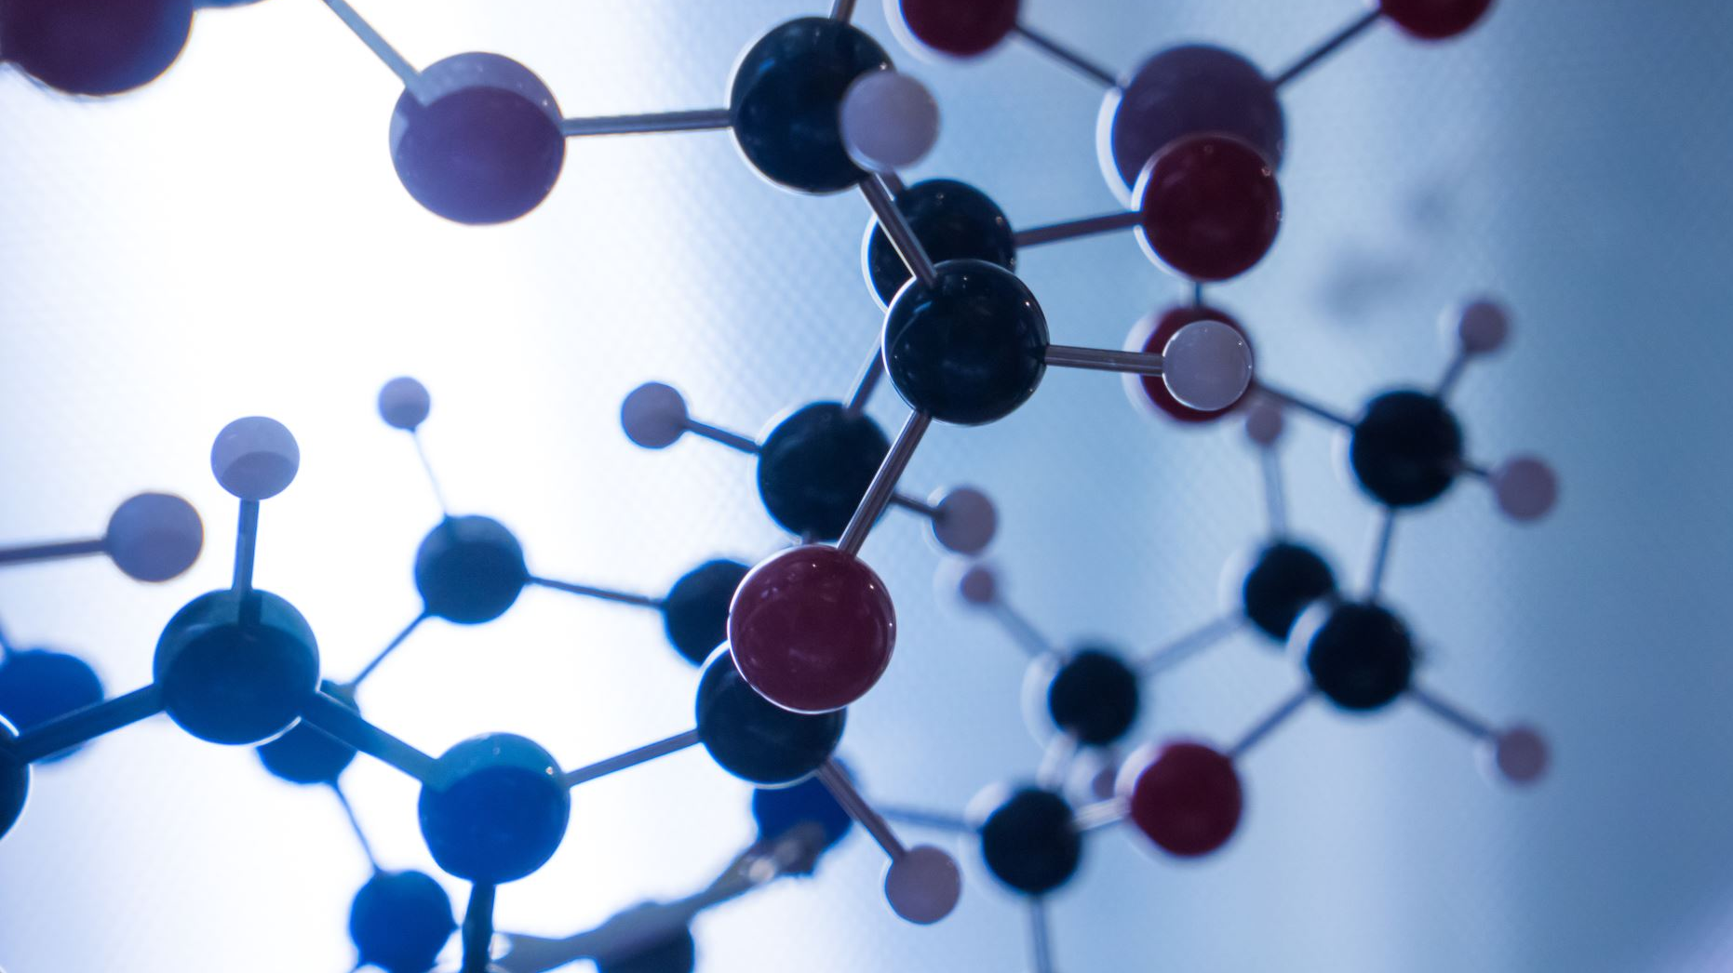
Basics of Atomic Theories
Atomic theory explains that matter is composed of extremely small particles called atoms. These atoms determine the physical and chemical properties of substances.
The idea of atoms evolved through many experiments and observations. Scientific models replaced early assumptions as technology improved.
Modern atomic theory uses quantum mechanics to describe atomic behavior, especially the movement of electrons around the nucleus.

Slide 3
Dalton’s Atomic Theory
John Dalton was the first scientist to propose a detailed atomic theory. He explained that matter consists of tiny particles which cannot be divided by chemical means.
Dalton stated that atoms of the same element have identical characteristics, while atoms of different elements differ. Compounds form through the combination of atoms in fixed ratios.
Although later discoveries showed atoms contain smaller particles, Dalton’s theory formed the foundation of atomic science.

Slide 4
Thomson, Rutherford, and Bohr Models
J.J. Thomson discovered electrons and suggested that atoms contain negative charges within a positive framework.
Rutherford’s gold foil experiment proved that atoms have a central nucleus containing most of the mass. This experiment showed that atoms are mostly empty space.
Bohr proposed that electrons move in specific energy levels, preventing them from collapsing into the nucleus and explaining atomic spectra.

Slide 5
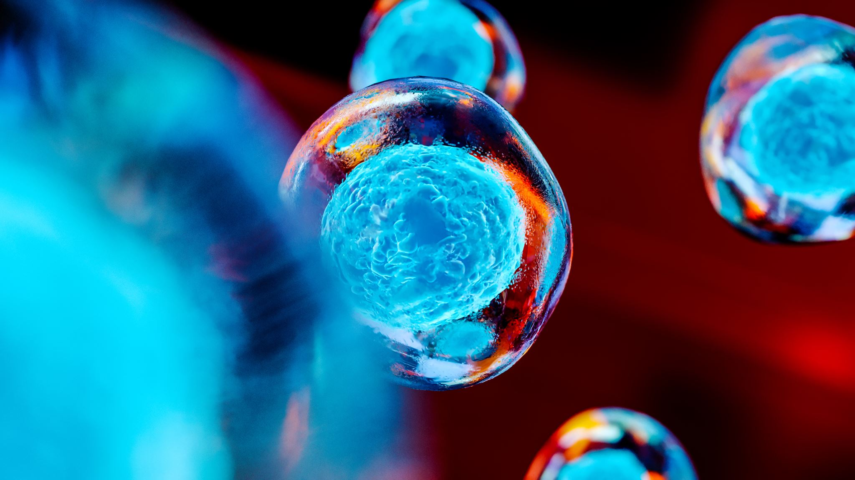
Introduction to Particle Physics
Particle physics studies the smallest known components of matter and their interactions. It helps explain the fundamental structure of the universe.
Scientists perform experiments using powerful accelerators to observe particle collisions. These experiments reveal new particles and interactions.
Particle physics has applications in medicine, technology, and cosmology.

Slide 6
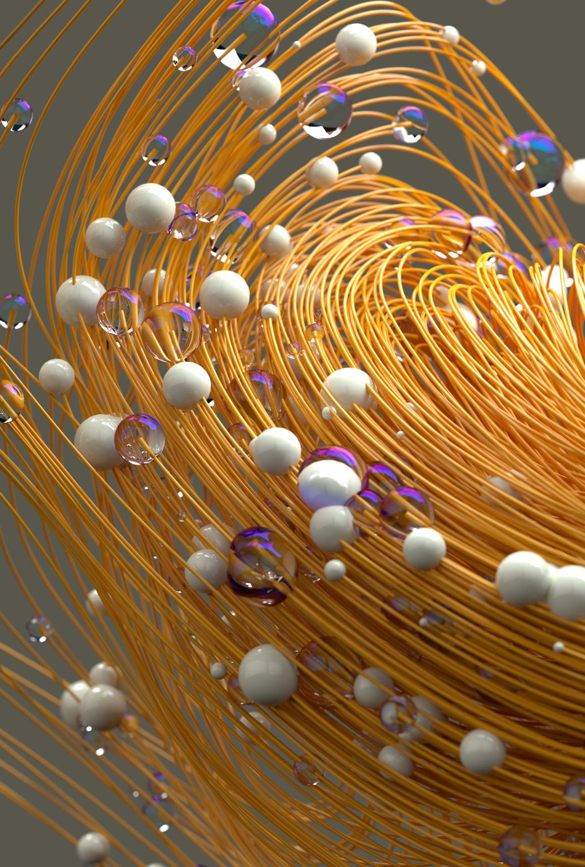
Fundamental Particles
Fundamental particles have no internal structure. They are grouped into fermions and bosons.
Fermions include quarks and leptons, which form all matter. Quarks combine to form hadrons like protons and neutrons.
Bosons act as force carriers and allow particles to interact with each other, such as photons for electromagnetic force.

Slide 7

Standard Model of Particle Physics
The Standard Model is a well-tested theory describing fundamental particles and their interactions. It explains three of the four fundamental forces.
It includes matter particles, force particles, and the Higgs boson, which provides mass to particles.
Despite its accuracy, the model does not explain gravity, so further theories are being developed.

